Slide 1
Mathematical Models of Systems
Chapter 2
Chapter 3
Time Domain Analysis of
Control Systems
Third Lesson

Slide 2
Reviews
Block diagram of a linear system
Block diagram transformation
Signal-flow graph
Gain formula (Mason Formula)
State space model
State equation versus transfer function – from SE to TF

Slide 3
Outlines
Chapter 2
Transfer function versus state equation – from TF to SE
Controllability canonical form (CCF)
Observability canonical form (OCF)
State diagram
How to use TF to solve the dynamic response of a system
How to solve a state equation
Chapter 3
Basics about time domain analysis
Stability definitions
  Liapunov stability
  Asymptotical stability
  BIBO stability

Slide 4
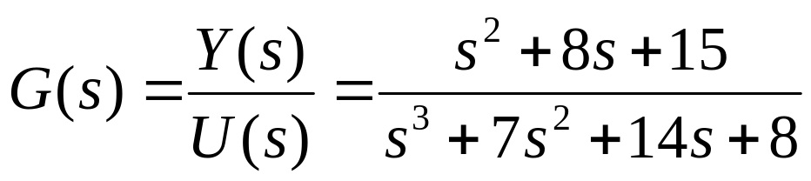
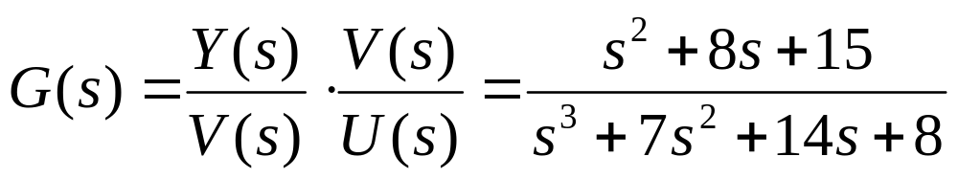
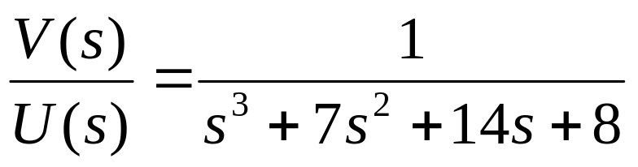
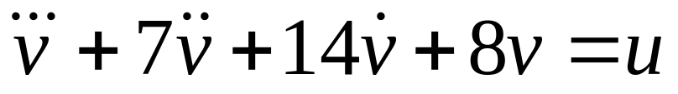
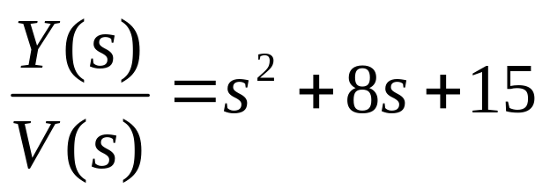
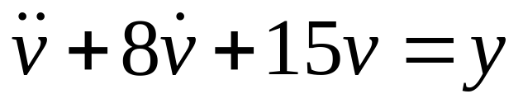
From TF to SE – An Example
Q: find a SE for the system described by the following TF
A: introduce an intermediate variable V(s) and rewrite Y(s), U(s)
as functions of V(s):
Notes:
State variables are not unique. There is no intuitive way to chose state variables for a transfer function in general form.

Slide 5
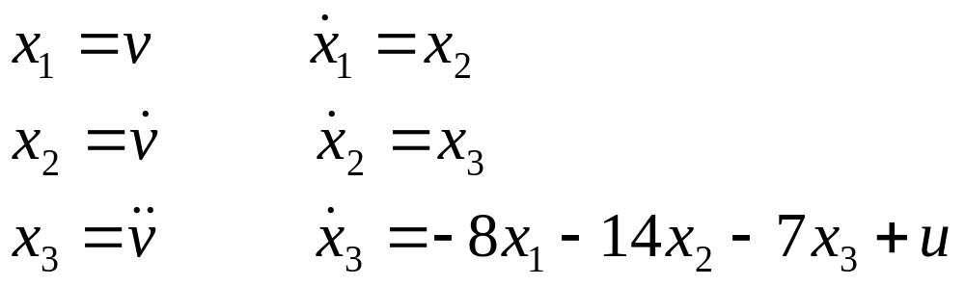
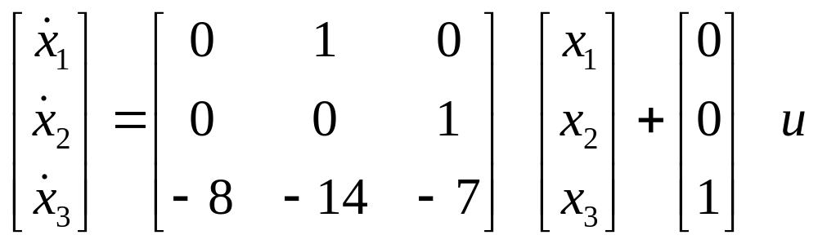
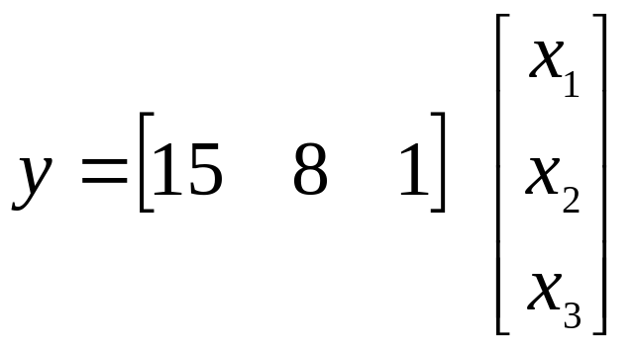
From TF to SE – An Example
If set:
Notes:
State variables are not unique. There is no intuitive way to chose state variables for a transfer function in general form.

Slide 6
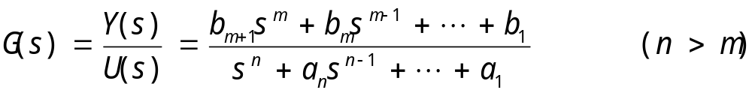
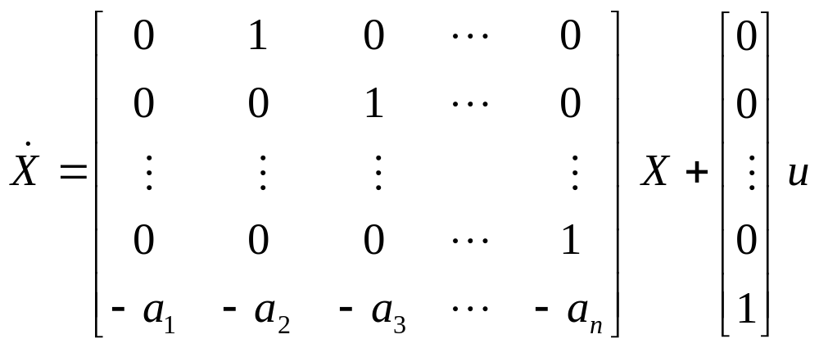
Controllability Canonical Form (CCF)

Slide 7
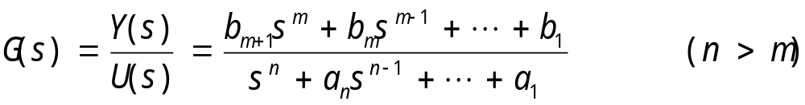
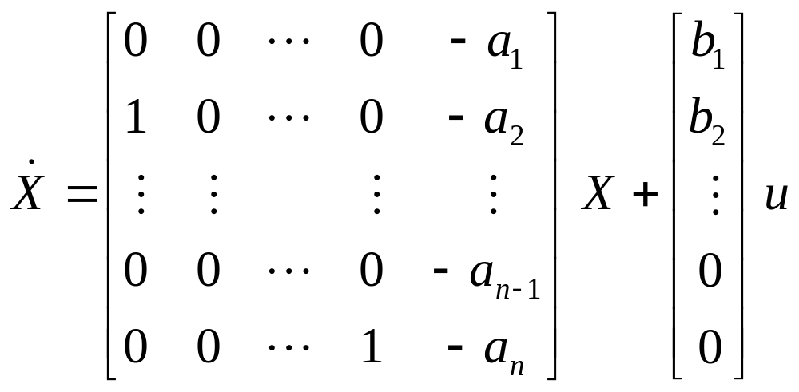
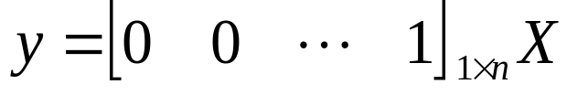
Observability Canonical Form (OCF)

Slide 8
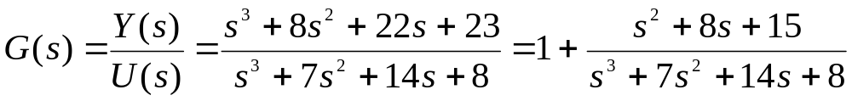
Remarks
There exist other canonical forms, such as Diagonal Canonical Form and Jordan Canonical Form.
There exist different ways to get those canonical forms.
If n=m, it is a non inertial system. Do division first to get an expression comprised of an integer and a fraction.

Slide 9
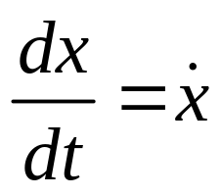
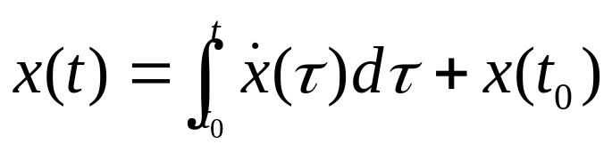
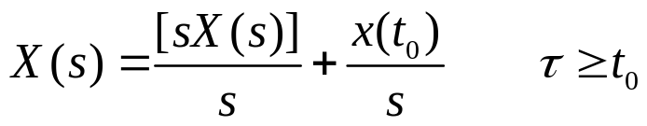
State Diagram
State diagram is an extension of SFG to portray state equations and differential equations.
The basic elements of a state diagram are similar to the conventional SFG, except for the integration operation.
Differential Equation:
Integration:
Laplace transform:
Notes:
Initial states are added.

Slide 10





State Diagram of An Integration

Slide 11
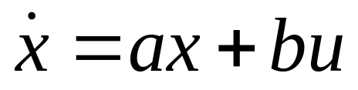
State Diagram of State Equations
x
(0
)
U
(
s
)
b
sX
(
s
)
X
(
s
)
·
u
·
x
x
a
X
(
s
)
Notes:
Adder or summator

Slide 12
Advantages of State Diagrams
A state diagram can be constructed directly from the system’s differential equation. This allows the determination of the state variables and the state equations.
A state diagram can be constructed from the system’s transfer function.
The state diagram can be used for the programming of the system on an analog computer or simulation on a digital computer
The transfer functions of a system can be determined from the state diagram
The state equations and the output equations can be determined from the state diagram.
Other advantages.

Slide 13
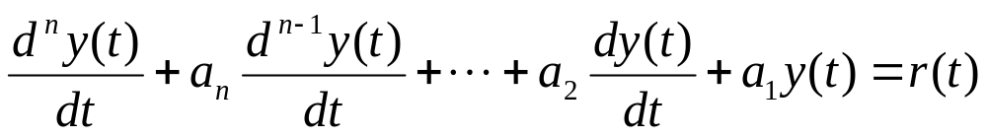
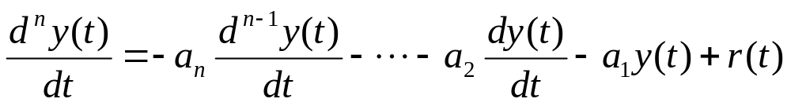












Example for Item 1
Q: Construct the SD of the following differential equation.
A: rearrange the equation as

Slide 14
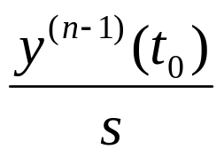
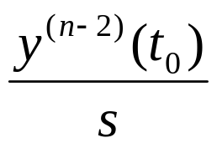
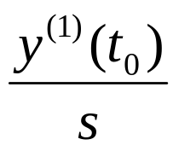
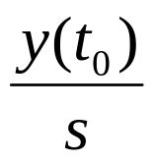


Slide 15
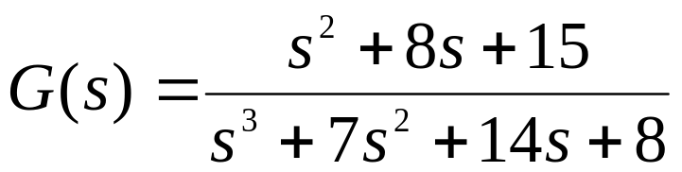
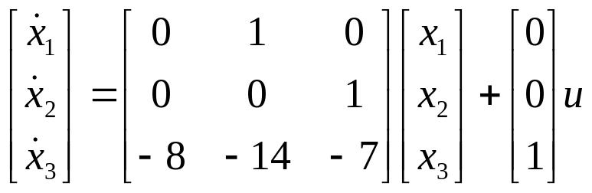
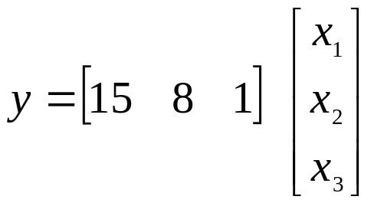












Example for Item 2
Q: Construct the SD from the following transfer function.
A: convert the TF to state equations

Slide 16
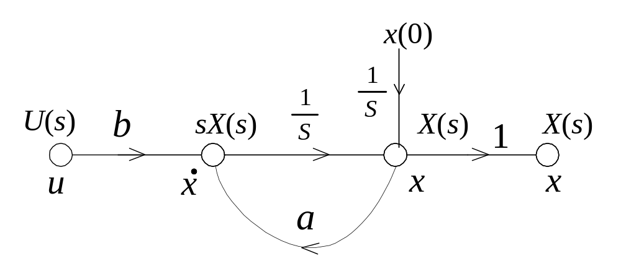
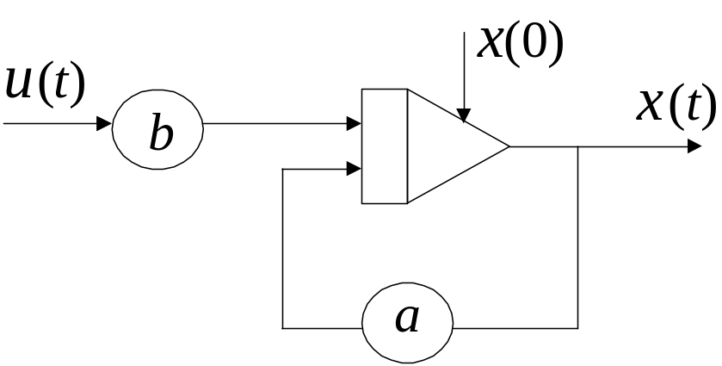
Example for Item 3
Notes:
Adder or summator

Slide 17
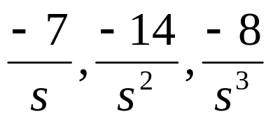
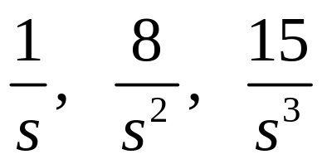
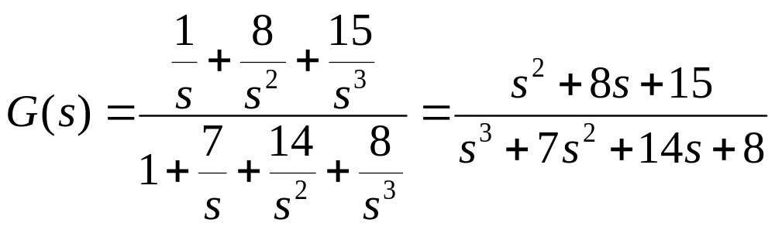
Example for Item 4
Q: Get the transfer function from the following SD.
A:
loops:
forward paths:

Slide 18
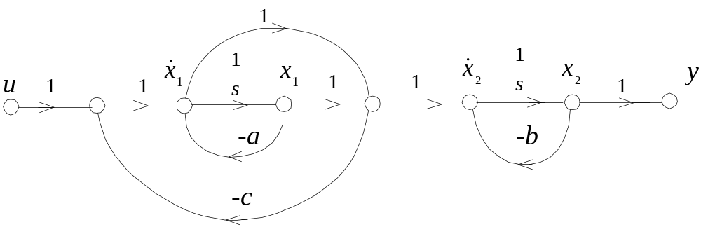

Example for Item 5
Q: Get the state equations from the following SD.
A: the general form of state equations is:
How to get the parameters?
Mason formula

Slide 19
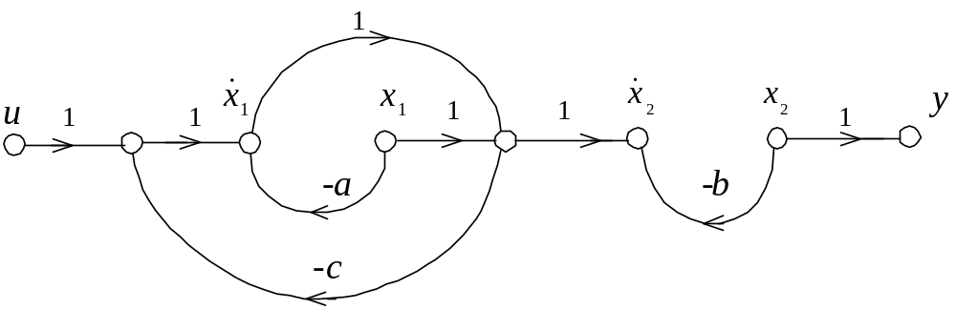
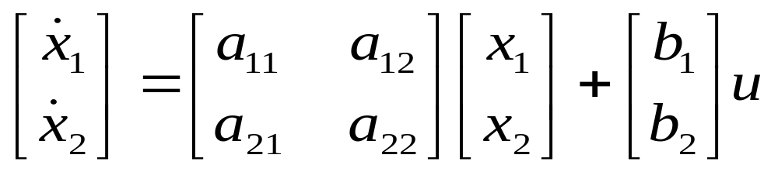


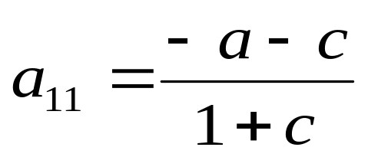
General form of state equations:
loops:
forward paths:
Notes:
Following the superposition principle to obtain elements of A and B. For example, a11 represents the relationship between x1 and x1 dot. We can assume x1 as an input and x1 dot as the output and use gain formula to obtain a11.

Slide 20
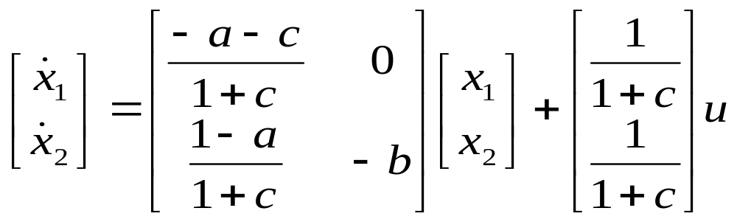
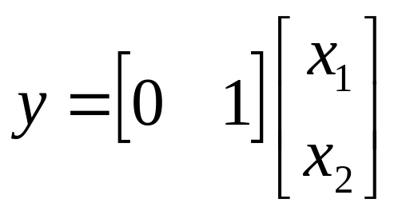
General form of state equations:
Notes:
Following the superposition principle to obtain elements of A and B. For example, a11 represents the relationship between x1 and x1 dot. We can assume x1 as an input and x1 dot as the output and use gain formula to obtain a11.

Slide 21
Milestone 1
Modeling of a LTI system
  ODE
  TF
  SE
Graphical description of a LIT system
  Block diagrams
  Signal flow graph
  State diagram

Slide 22
Next Milestone
Solving a LTI system
  What does it mean to solve a LTI system
  How to solve a LTI system
    Solve ODEs
    Solve TF
    Solve SE

Slide 23
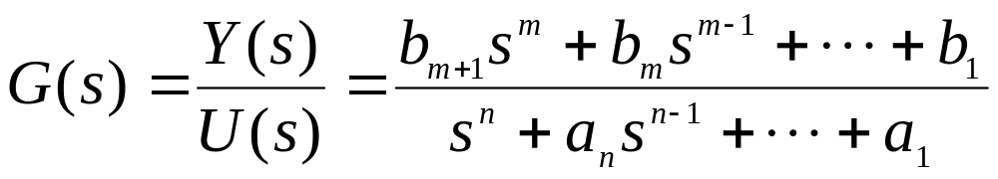


Application of TF to the Solution of Response
What does it mean to solve a LTI system？
For a LTI system which is expressed by a TF
（n≥m )
Find the time-domain response of the system subject to an input.

Slide 24
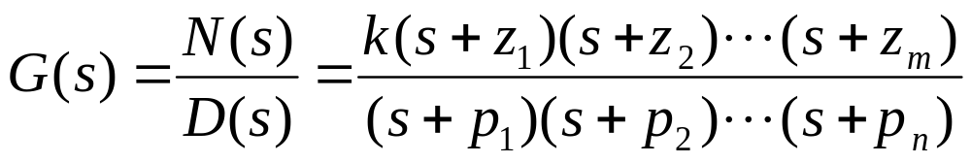
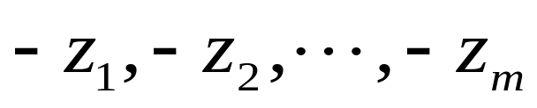
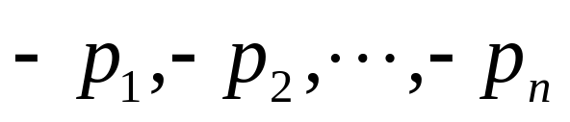
Application of TF to the Solution of Response
Basic definitions:
（n≥m )
Perform partial-fraction expansion:
（n≥m )
Zeros, roots of N(s)=0
Poles, roots of D(s)=0
D(s)=0: characteristic equation
Notes:
factorization

Slide 25
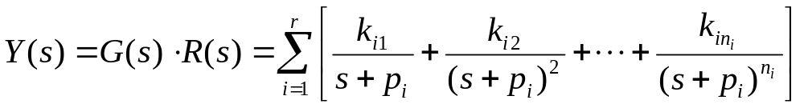
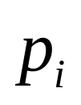


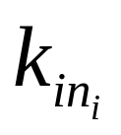
Application of TF to the Solution of Response
Suppose we have a response subject to an input R(s)
where
are poles;
is the number of poles, including simple
poles and multi-order poles;
is the order of
.
is the
residue of
.
Notes:
G(s)*R(s) is a rational function of s. If partial-fraction expansion is performed, an expression like this can be gotten.

Slide 26
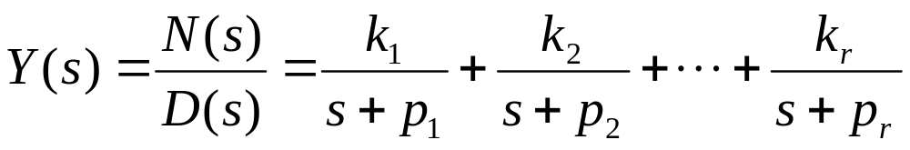
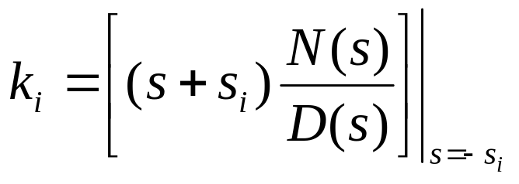
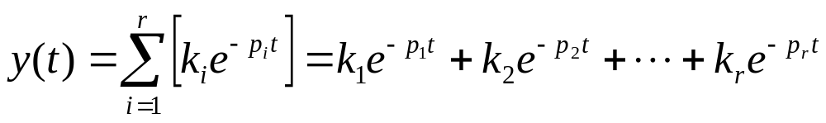
Application of TF to the Solution of Response
If there only exist simple poles,
Time-domain response is:
Notes:
Dynamic modes: period and rate of attenuation

Slide 27



Application of TF to the Solution of Response
Dynamic modes are determined by poles;
Magnitude and phase are affected by zeros.

Slide 28
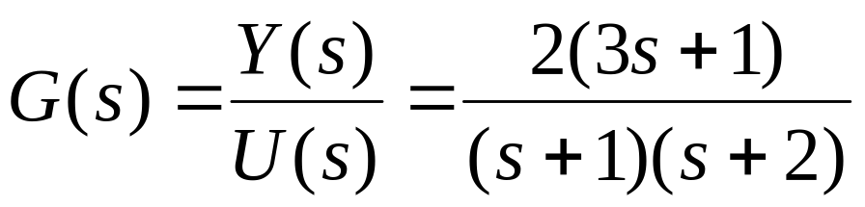




Example 2.18
Q: Give out the form of the response of the following system subject to the given input signal.
A:
Laplace transform of the input:
Frequency domain response:
Time domain response:

Slide 29








Example 2.19
Q: Compare the responses of the following two systems to the same unit-step signal.
A:
Laplace transform of the input:
Zero of G₁:
Zero of G₂:
Time domain response:

Slide 30





Example 2.20
Q: find the response of the following system to the given input signal.
A:
Laplace transform of the input:
Frequency domain response:
Time domain response:
Zero-pole cancellation blocks the cancelled mode from showing up
in the output.

Slide 31




Application of TF to the Solution of Response
What does it mean to solve a LTI system？
For a LTI system which is expressed by a state space model
SISO, first-order ODE, zero-input
Q:
A:
Find the time-domain trajectory of the state variable
subject to the initial condition.

Slide 32





The Solution of State Equations
SISO, first-order ODE
Q:
A:
Real Convolution
Find the time-domain trajectory of the state variable
subject to both the initial condition and the input.

Slide 33





The Solution of State Equations
MIMO, nth-order ODE
State-Transition Matrix
Notes:
Matrix exponential
Identity matrix

Slide 34

The Solution of State Equations
How to prove

Slide 35

The Solution of State Equations
How to prove

Slide 36


The Solution of State Equations
Both sides are multiplied with

Slide 37

The Solution of State Equations

Slide 38





The Solution of State Equations
Important feature of

Slide 39



Example 2.21
Q: find the response of the following system to the unit-step input
A: Laplace transform of the state equation
First item
Notes:
Adjoint matrix 伴随矩阵
Reciprocal of the determinant of the matrix 矩阵行列式的倒数

Slide 40


Example 2.21
the state-transition matrix
the second item

Slide 41


Example 2.21
the response to the unit-step input:

Slide 42
Time Domain Analysis of
Control Systems
Chapter 3

Slide 43
Outlines
Chapter 2
Transfer function versus state equation – from TF to SE
Controllability canonical form (CCF)
Observability canonical form (OCF)
State diagram
How to use TF to solve the dynamic response of a system
How to solve a state equation
Chapter 3
Basics about time domain analysis
Stability definitions
  Liapunov stability
  Asymptotical stability
  BIBO stability

Slide 44
Basics in Control System Analysis
Among the many forms of performance specifications used in design, the most important requirement is that the system be stable.
When all types of systems are considered – linear, nonlinear, time-invariant, and time-varying – the definition of stability can be given in many forms.
For analysis and design purposes, we can clarify stability as absolute stability and relative stability.
Absolute stability refers to the condition of whether the system is stable or unstable; it is a yes or no answer.
Relative stability refers to the degree of stability; it defines how stable a stable system is.
Notes:
An unstable systems is generally considered to be useless.
For analysis and design purposes, we can clarify stability as absolute stability and relative stability.

Slide 45
Basics in Control System Analysis
Why analyze?
Analyze what?
How to analyze?
Notes:
An unstable systems is generally considered to be useless.
For analysis and design purposes, we can clarify stability as absolute stability and relative stability.

Slide 46
Basics in Control System Analysis
In preparation of the definition of stability, we define the following two types of responses for LTI systems:
  Zero-state response: the zero-state response is due to the input only; all the initial conditions of the system are zero.
  Zero-input response: the zero-input response is due to the initial conditions only; all the inputs are zero.
  From the principle of superposition, when a system is subject to both inputs and initial conditions, the total response is written
    total response = zero-state response + zero-input response

Slide 47



Zero-input Stability (Liapunov Stability)
Zero-input stability refers to the stability condition when the input is zero, and the system is driven by its initial conditions.
A LTI dynamic system without input is depicted by a homogeneous ODE
Solution:
Modes:
Notes:
The zero-input stability is firstly defined by Russian scientist Liapunov, it is also named as Liapunov Stability.
Lambda is the eigenvalue of A, which is a complex number. It is also the root of the characteristic equation.
The solution of the ODE is a linear combination of different modes.

Slide 48






Definition of Zero-input Stability
System trajectory can be sketched in the phase space:
Different initial points are corresponding to different system trajectories.

Slide 49

Definition of Zero-input Stability
Assume a system has an equilibrium point:
I want the system trajectories to be within a certain range of
Can you tell me what range the initial point should be located in?

Slide 50





Definition of Zero-input Stability
A system:
Equilibrium point:
Given finite trajectory:
Initial condition range:

Slide 51


Definition of Zero-input Stability
Solution:
Modes:

Slide 52

Stability Region in S-plane
plane

Slide 53


Asymptotic Stability
A system:
Equilibrium point:
Finite initial condition:
Finite response:

Slide 54




Bounded-Input Bounded-Output Stability
Definition of Zero-State Stability
Definition: let
and
be the input, output, and
be the input, output, and
impulse response of a linear time-invariant system, respectively.
With zero initial conditions, the system is said to be bounded-
input bounded-output (BIBO) stable, or simply stable, if its
output
is bounded to a bounded input
What’s the sufficient and necessary condition for BIBO stable?

Slide 55







Definition of Zero-State Stability
The convolution integral:
The absolute value:
If u(t) is bounded:
M is a finite positive number
If y(t) is bounded:
The condition:

Slide 56





Zero-State Stability Criterion
Study the stability condition in s-plane:
Laplace transform of
,
Where s is a complex number,
,
are real numbers.
The dynamics of a control system is determined by its poles, so we
need to study the above equation when s is a pole.

Slide 57





Zero-State Stability Criterion
If s is a pole of G(s), and considering
,
If one or more roots of the characteristic equation are in the right-half s-plane or on the imaginary axis,
Then:
So:
This conflicts with the stability condition!
Notes:
Reduction to absurdity

Slide 58




Zero-State Stability Criterion
Thus, for BIBO stability, the roots of the characteristic equation, or
the poles of G(s), cannot be located in the right-half s-plane or on the
imaginary axis, or they must lie in the left-half s-plane.
A system is said to be unstable if it is not BIBO stable. When a system
has roots on the imaginary axis, say, at
and
,
if the input is a sinusoid,
,
the output will be of the form of
,
which is unbounded, and the system is unstable.

Slide 59










Example – 3.1
Q: find the response of the following circuit to given inputs, and analyze its BIBO stability.
(1) When the input is
Notes:
For any omiga, the output is bounded

Slide 60





Example – 3.1
(2) When the input is
Is the system BIBO stable?
What can we get from this example?
Notes:
If a system BIBO stable, its output should be always bounded no matter what the input is.

Slide 61


Example – 3.2
Q: find if the following system BIBO stable, asymptotic stable.
A: the transfer function of the above system is:
One pole is at -1, a cancelled pole is at -2. Both are located at the
left-half s-plane. The system is both BIBO and asymptotic stable.
Notes:
If the cancelled pole is one the right-half s-plane, the system is BIBO stable but not asymptotic stable.

Slide 62
Wrap-up
Transfer function versus state equation – from TF to SE
Controllability canonical form (CCF)
Observability canonical form (OCF)
State diagram
How to use TF to solve the dynamic response of a system
How to solve a state equation
Basics about time domain analysis
Stability
  Zero-State & Zero-Input Response
  Liapunov stability
  Asymptotical stability
  BIBO stability

Slide 63

Assignment
Chapter2 Page 35
10, (3)
Page 36
12，(3)
Page 37
13，(b)
15
17, (3)

Slide 64

DISCUSSION
Is a time delay block a linear block?

Slide 65


DISCUSSION
Basic idea:
According to the definition, if and only if a system satisfies the following two requirements, it is a linear system:
Principle of superposition
Property of homogeneity

Slide 66










DISCUSSION
Proof：
Principle of superposition
There is a time delay block whose parameter is .
With two inputs and ,
corresponding outputs are
Let denote the sum of and
The output of the time delay block with respect to is
Thus, the principle of superposition holds

Slide 67





DISCUSSION
Proof：
Property of homogeneity
is denoted as :
The output of the time delay block with respect to is
Thus, the property of homogeneity holds
Now, we have proved that a time delay block is a linear block.

Slide 68



DISCUSSION
Further information：
In time domain, the time delay block is not a linear function
with respect to time t , but it is a linear block with respect to the input .
In s domain, the Laplace transform of the time delay block
is not a linear function with respect to the parameter s , but it is still a linear block with respect to the input.

